Slide 1
Reasons for choosing 4% as the threshold

Slide 2
Criteria for choosing successful projects
we selected “successful projects” based on two criteria.
First, success indicators’ disparity of successful projects and unsuccessful projects should be as large as possible to clearly differentiate between successful projects and unsuccessful projects.
Second, we need enough 1-samples to make sure our results from logistic regression models are stable

Slide 3
Distribution of success dimensions on projects
We find that the distribution of success dimensions are very skewed on projects. See material (star,watcher,committer,member).pdf and (star,watcher,committer,member)_y_log.pdf (Y-axis logified version)

Slide 4
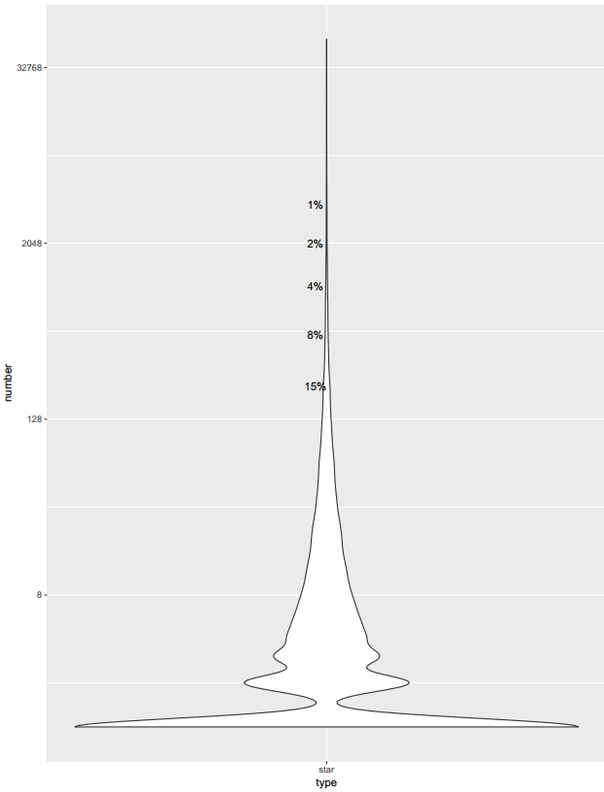
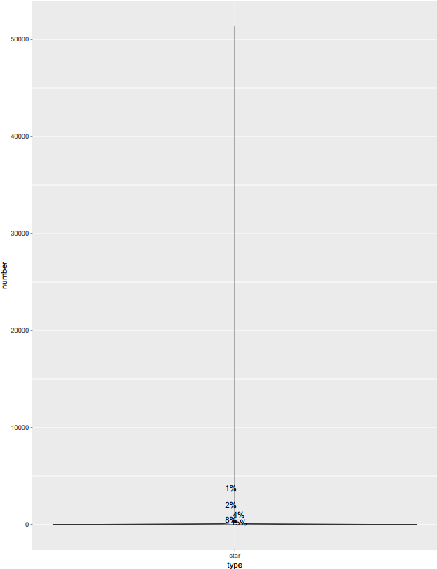
Example (star)
Log_processed
Normal version

Slide 5
However, from the two versions showed above, we cannot directly choose a proper threshold. Because log processing will cause distribution distortion, and normal version is too crowded that can not observe the distribution clearly. To solve this problem, we provided zoom_in version.(xxxx_zoomin.svg)

Slide 6
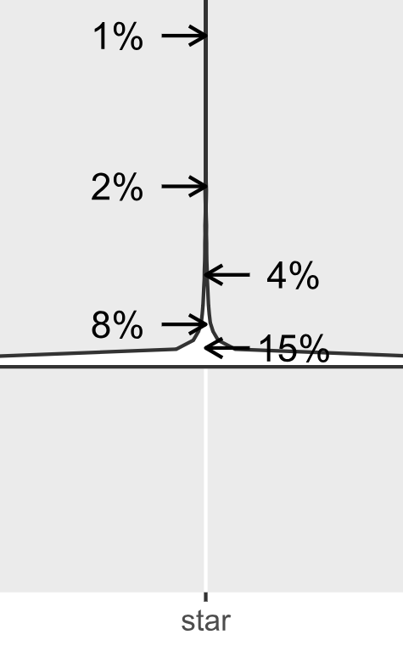
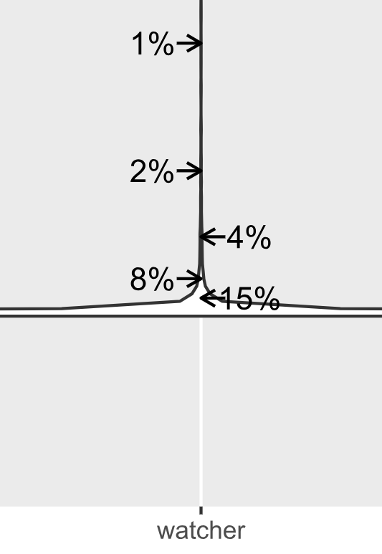

Slide 7
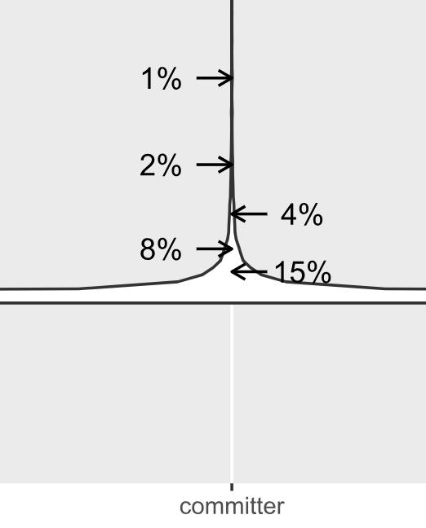
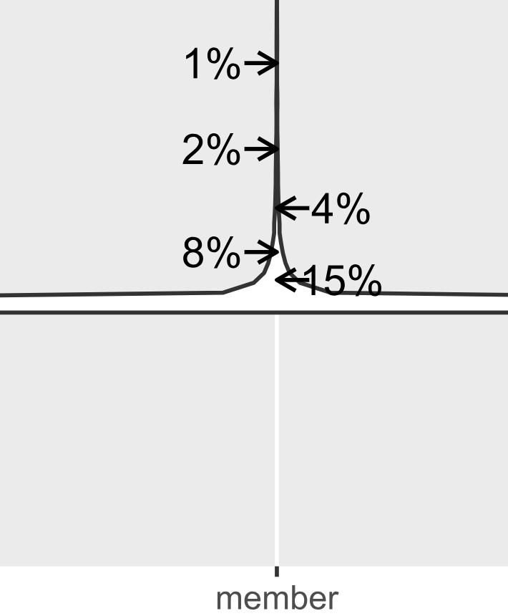

Slide 8
We can see clearly from zoom_in version that project number start to grow dramatically around the point 4%. Considered the criteria for choosing successful projects discussed above. The point can satisfy our need of enough 1-samples and at the same time it can clearly separate other projects from very “successful” projects (at least in these dimensions).

